Slide 1
INTERNET PROTOCOLS
Parshuram Sharma

Slide 2
Introduction
The Internet Protocol (IP) is the principal communications protocol in the Internet protocol suite for relaying datagrams across network boundaries.
Its routing function enables internetworking, and essentially establishes the Internet.
IP has the task of delivering packets from the source host to the destination host specially based on the IP addresses in the packet headers.

Slide 3
Function of IP
The Internet Protocol is responsible for addressing host interfaces, encapsulating data into datagrams (including fragmentation and reassembly) and routing datagrams from a source host interface to a destination host interface across one or more IP networks.
Internet Protocol, or IP, is the method that governs how computers share data across the Internet.
When one computer sends data, such as an email or a web form, its message gets parsed into small packets that contain the sending computer's Internet address, the receiving computer's address, and part of the message.

Slide 4
The Internet Protocol (IP)
Application Services
(Telnet, FTP, e-mail, WWW)
Reliable Transport Service
(TCP)
Connectionless Packet Delivery Service
(IP)

Slide 5
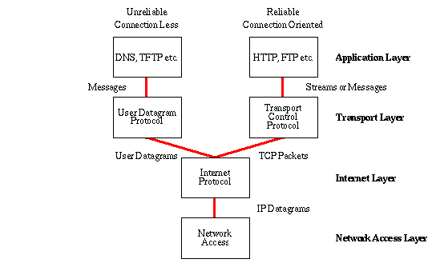
The Internet Protocol Stack

Slide 6
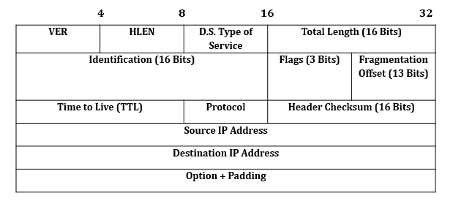
IP Header Format

Slide 7
Version: This Field defines the version of IP. It is Static 4 bit value.
Header Length: This Field defines the length of the datagram header. It is 4 bit value.
Type of Service: It is 8 bit value. It is used tell the network how to treat the IP packet. These bits are generally used to indicate the Quality of Service (QoS) for the IP Packet.
Packet Length: 16 bit value indicating the size of the IP Packet in terms of bytes. This gives a maximum packet size of 65536 bytes.
Identification: 16 bit field used for reassembling the packet at the destination.
Flags: It is 3 bits value. It indicates if the IP packet can be further fragmented or not and if the packet is the last fragment or not of a larger transfer.
Fragment offset: 13 bit value used in the reassembly process at the destination.
Time to Live: 8 bit value telling the network how long an IP packet can exist in a network before it is destroyed.
Protocol: 8 bit value used to indicate the type of protocol being used (TCP, UDP etc.).
Header checksum: It is 16 bit value. It is used to indicate errors in the header only. Every node in the network has to check and re-insert a new checksum as the header changes at every node.
Source address: 32 bit value representing the IP address of the sender of the IP packet.
Destination address: 32 bit value representing the IP address of the packets final destination.
Options: Options are not required for every datagram. They are used for network testing and debugging.
Padding: Variable size bit field. These bits are used to ensure a 32 bit boundary for the header is achieved.

Slide 8
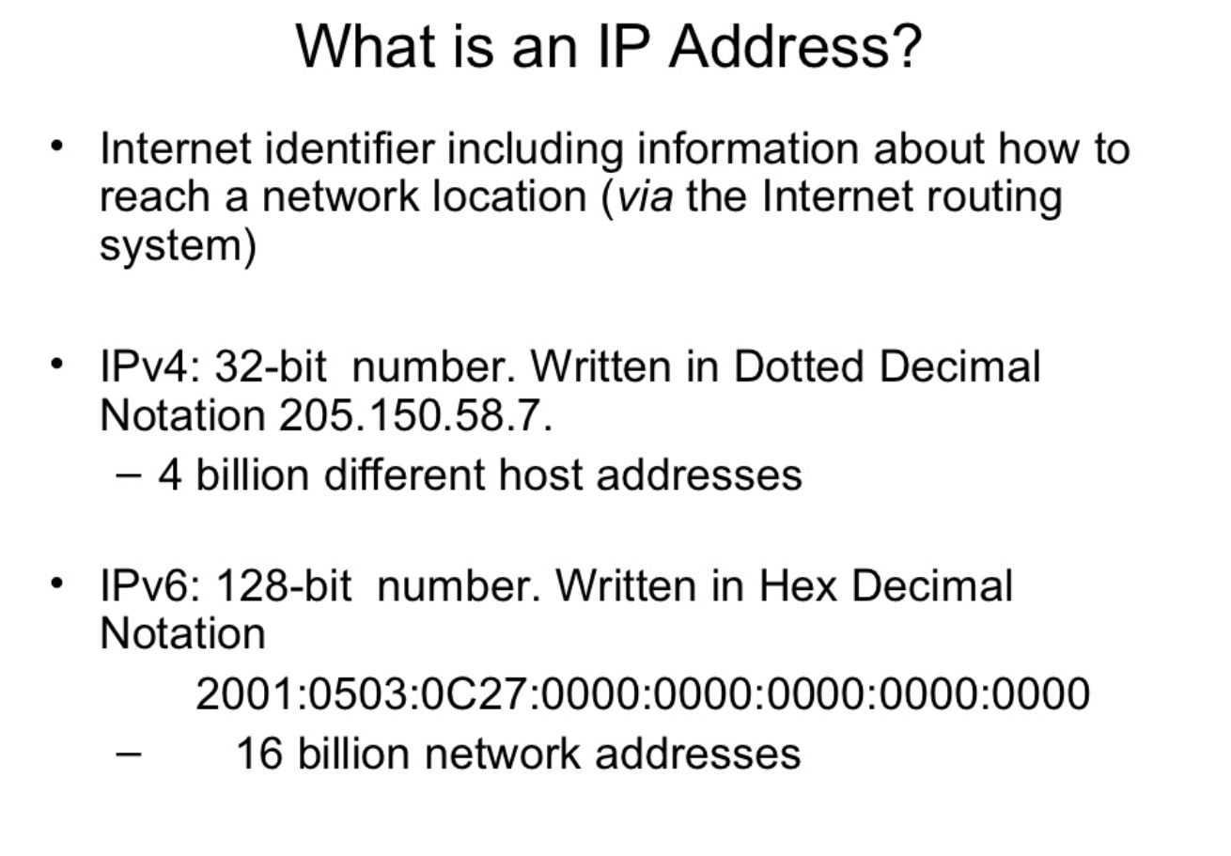

Slide 9
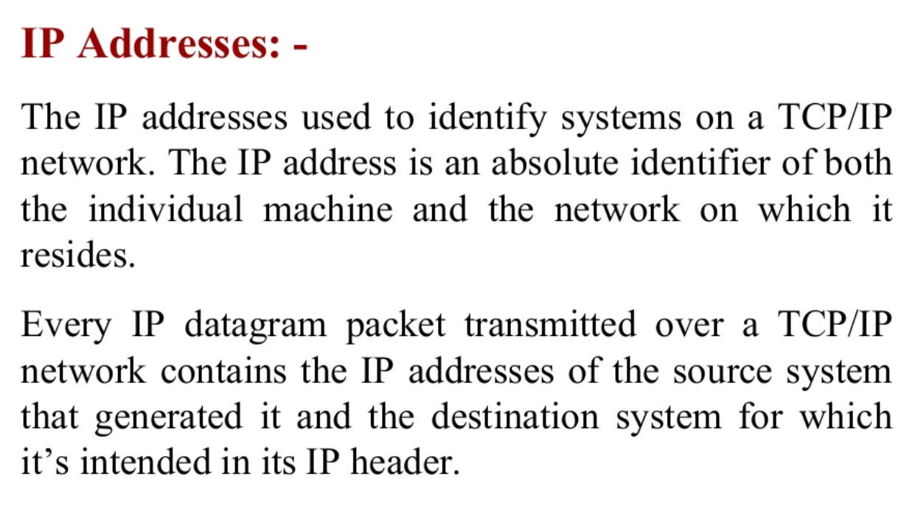

Slide 10
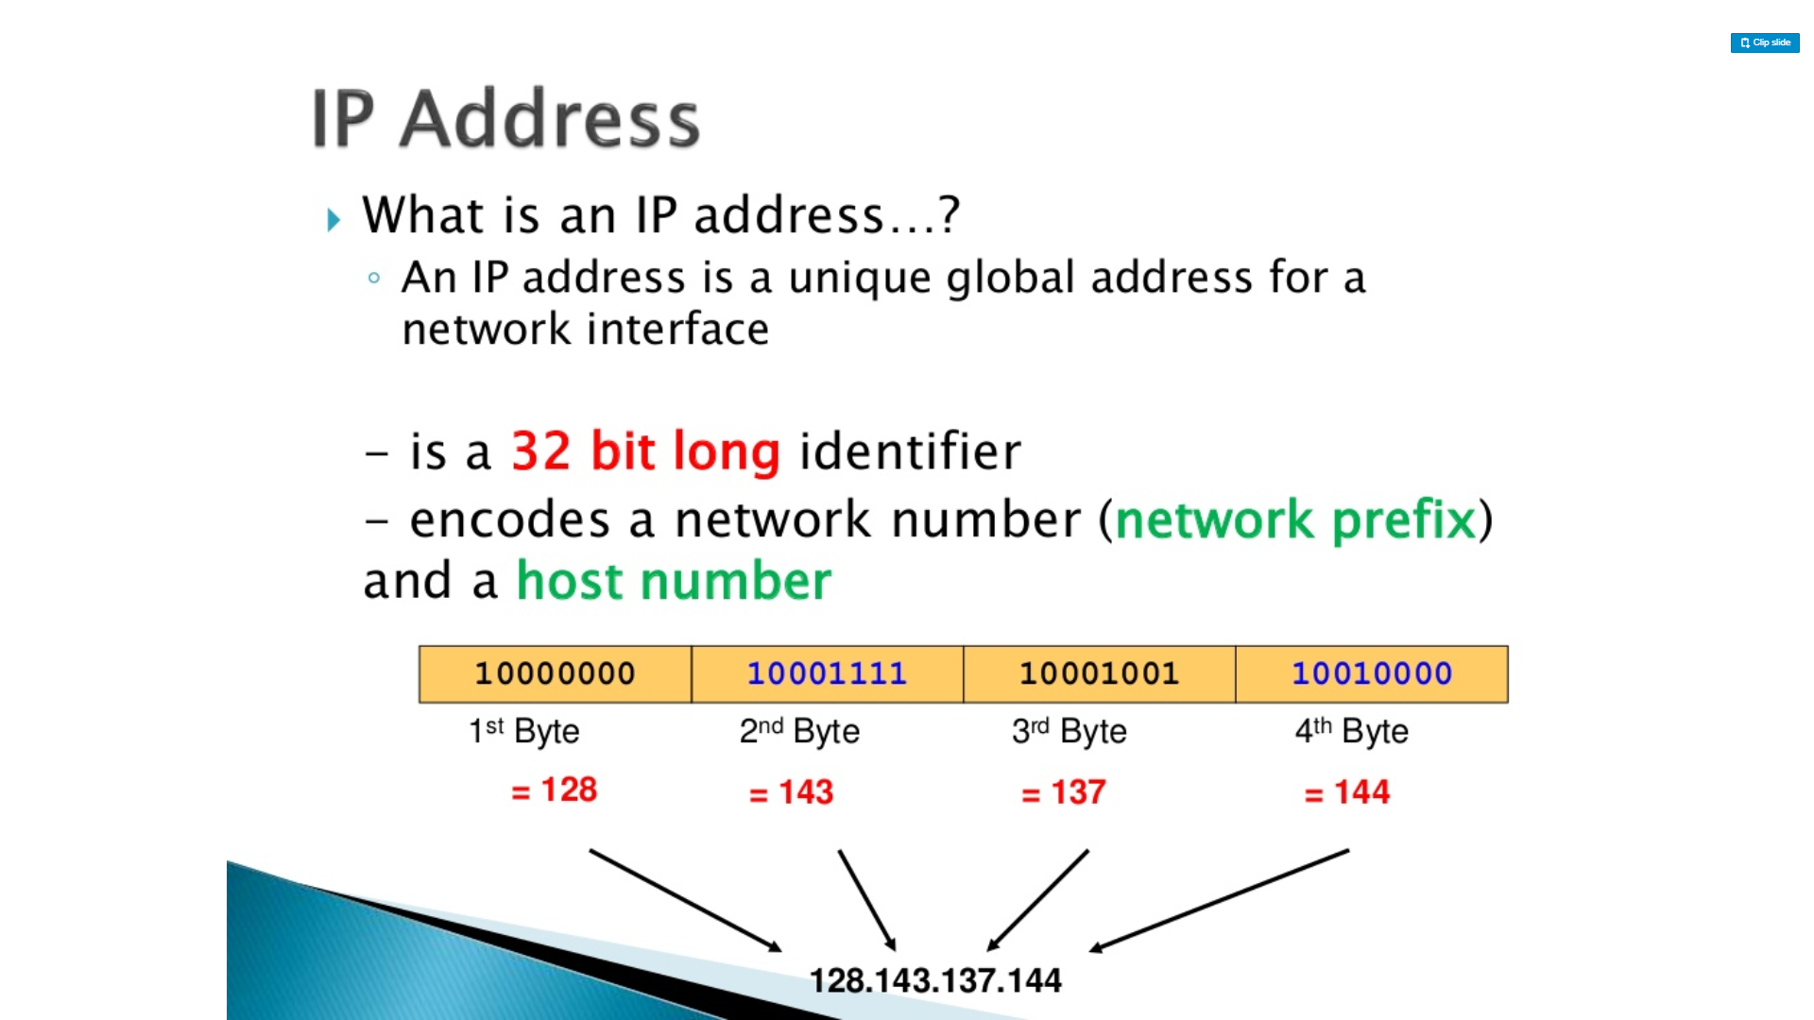

Slide 11
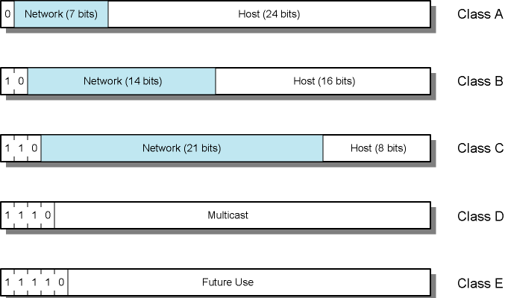
IPv4 Address Formats
32 bit global Internet address
Network part and host part
All-zero host part identifies the network
All-one host part means broadcast (limited to current network)

Slide 12
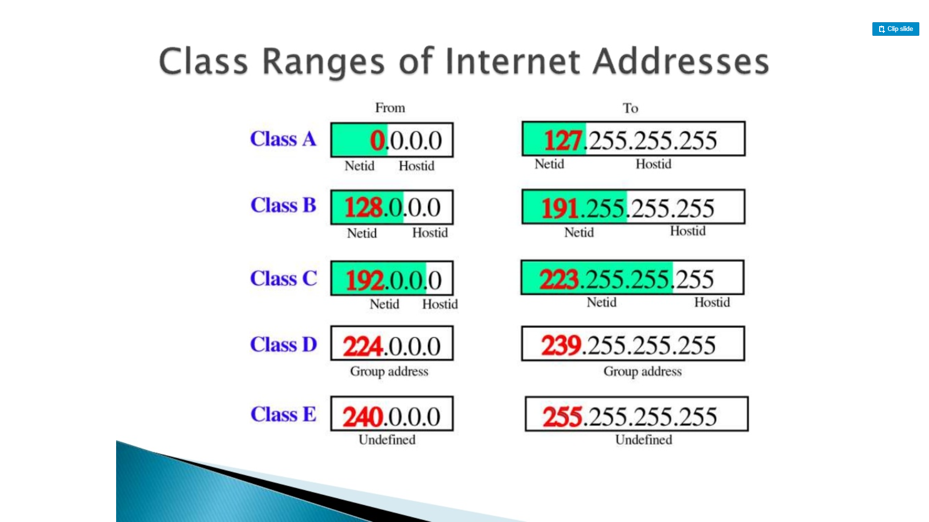

Slide 13
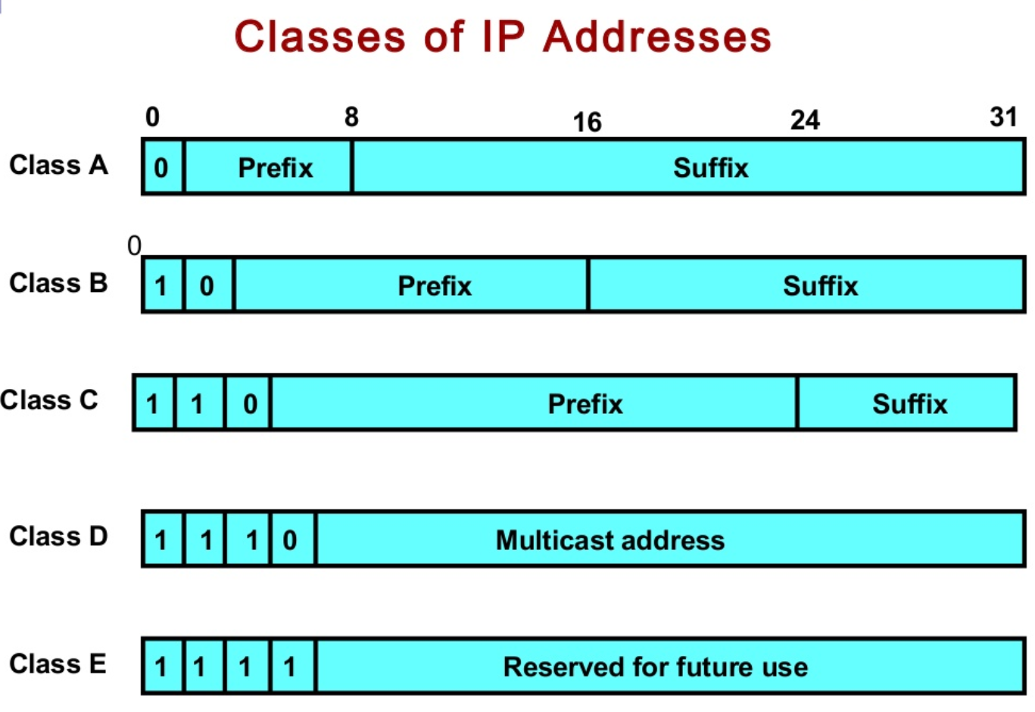

Slide 14
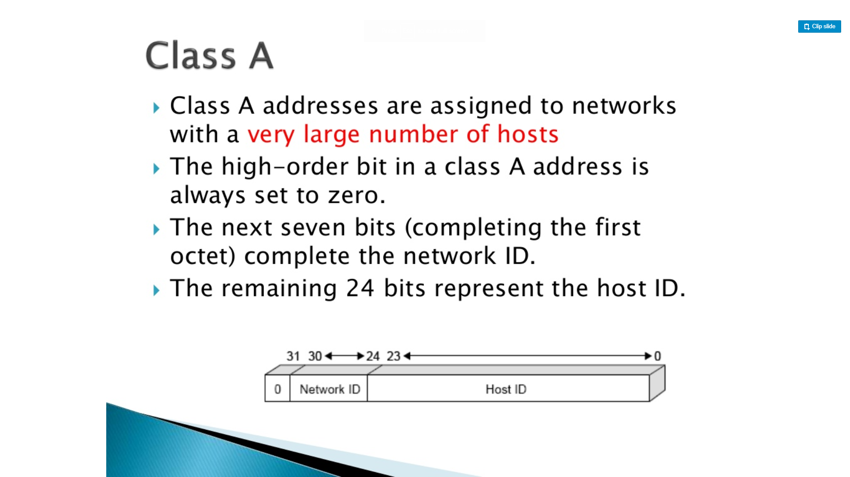

Slide 15
IP Addresses - Class A
Start with binary 0
7-bit network - 24-bit host
All zero
Special meaning (means “this computer”)
01111111 (127) (network part ) reserved for loopback
Generally 127.0.0.1 is used
Range 1.x.x.x to 126.x.x.x
10.x.x.x is for private networks
Few networks - many hosts
All networks have been allocated

Slide 16
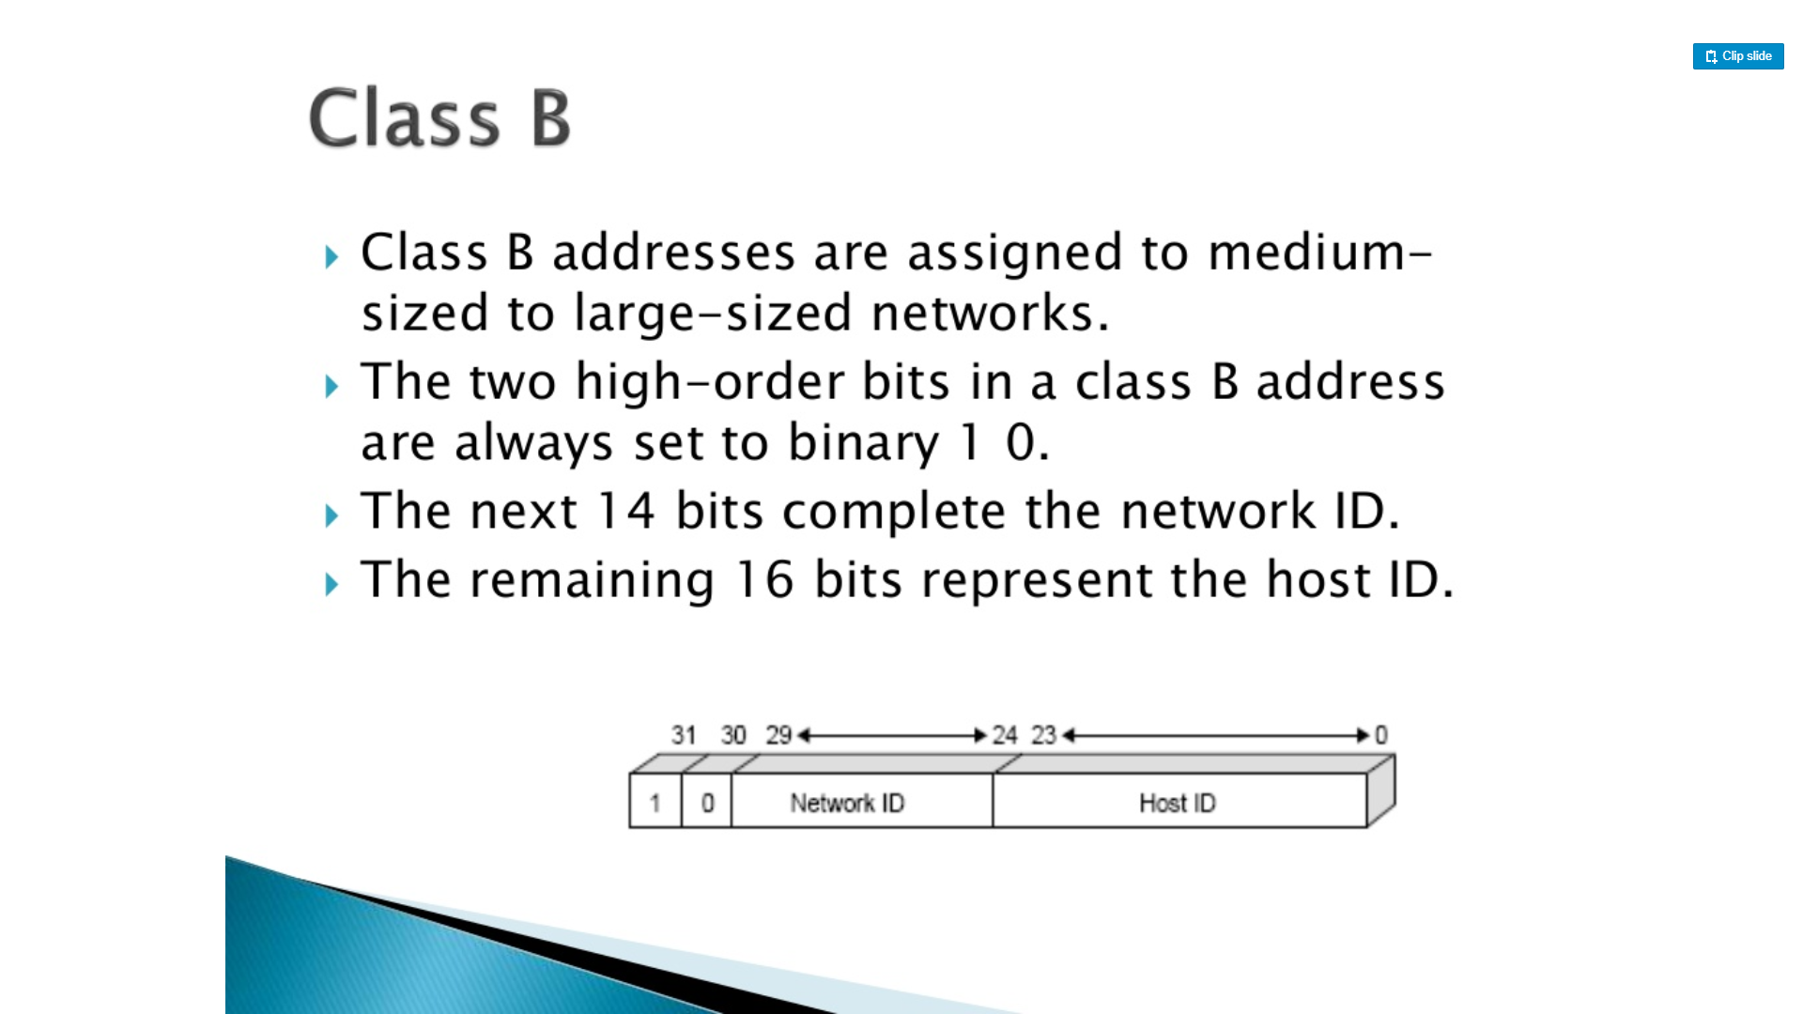

Slide 17
IP Addresses - Class B
Starts with binary 10
Range 128.x.x.x to 191.x.x.x
Second octet is also part of the network id.
14-bit network, 16-bit host number
2¹⁴ = 16,384 class B addresses
2¹⁶ = 65,536 hosts per network
Actually minus 2 due to network and broadcast addresses
All networks have been allocated

Slide 18
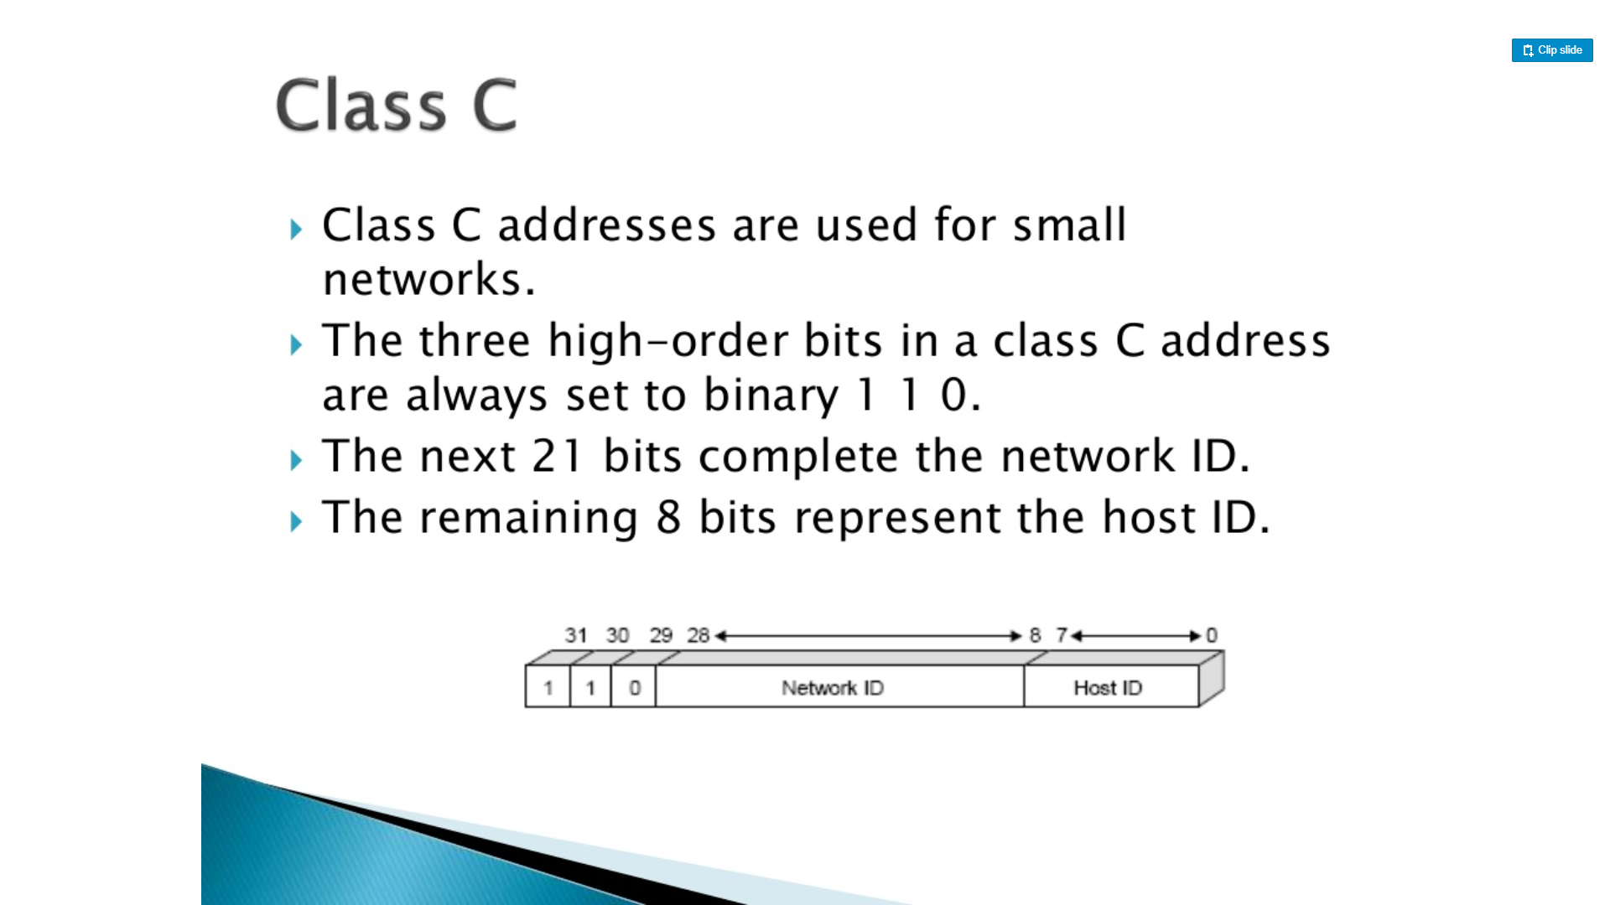

Slide 19
IP Addresses - Class C
Start binary 110
Range 192.x.x.x to 223.x.x.x
Second and third octets are also part of network address
2²¹ = 2,097,152 addresses (networks)
256 – 2 = 254 hosts per network
Nearly all allocated

Slide 20
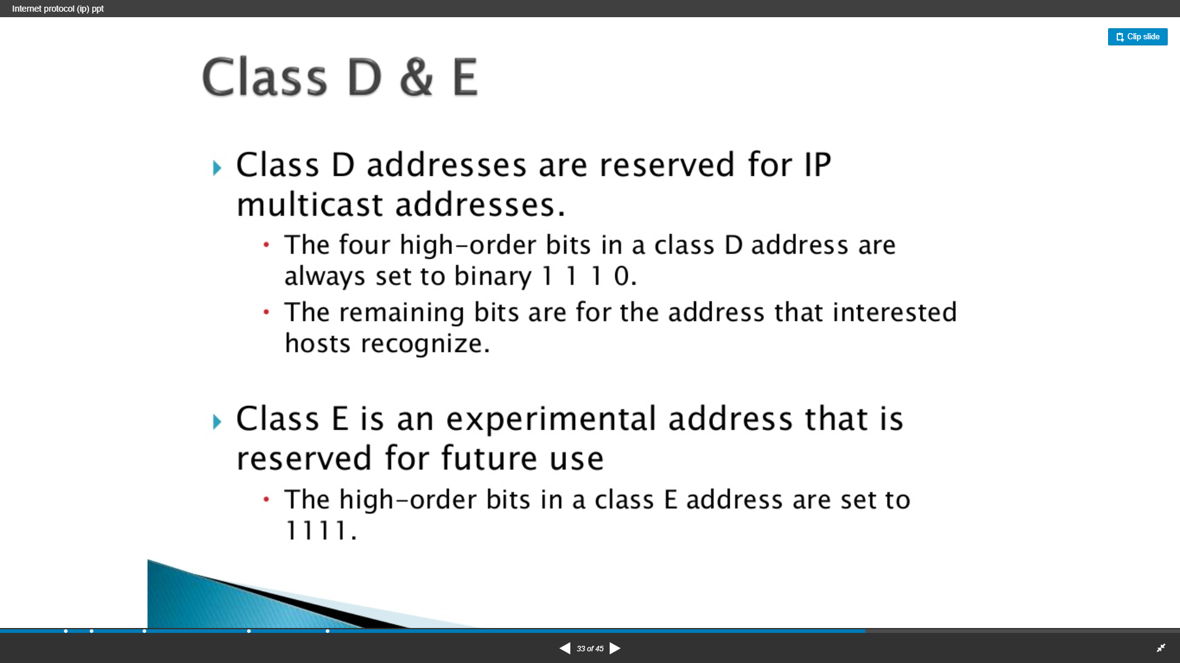

Slide 21
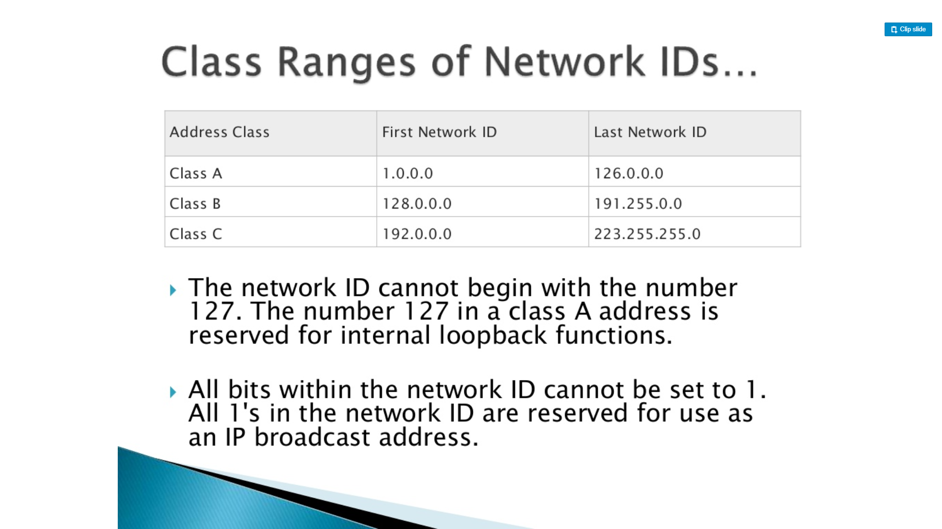

Slide 22
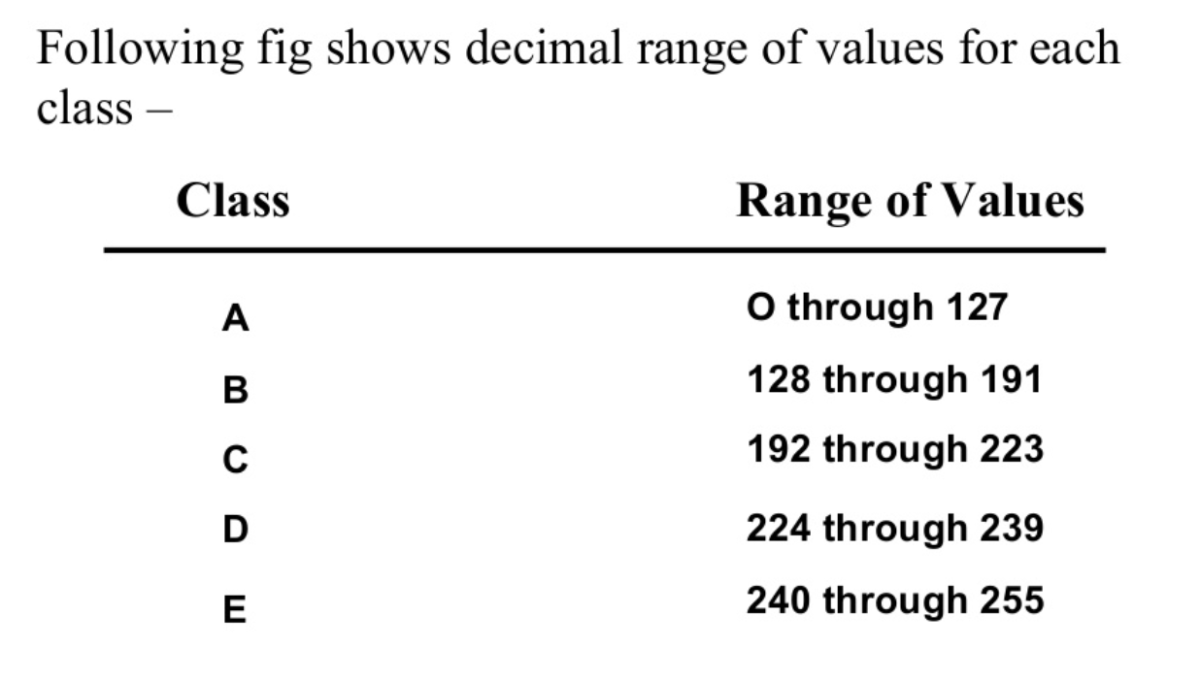

Slide 23
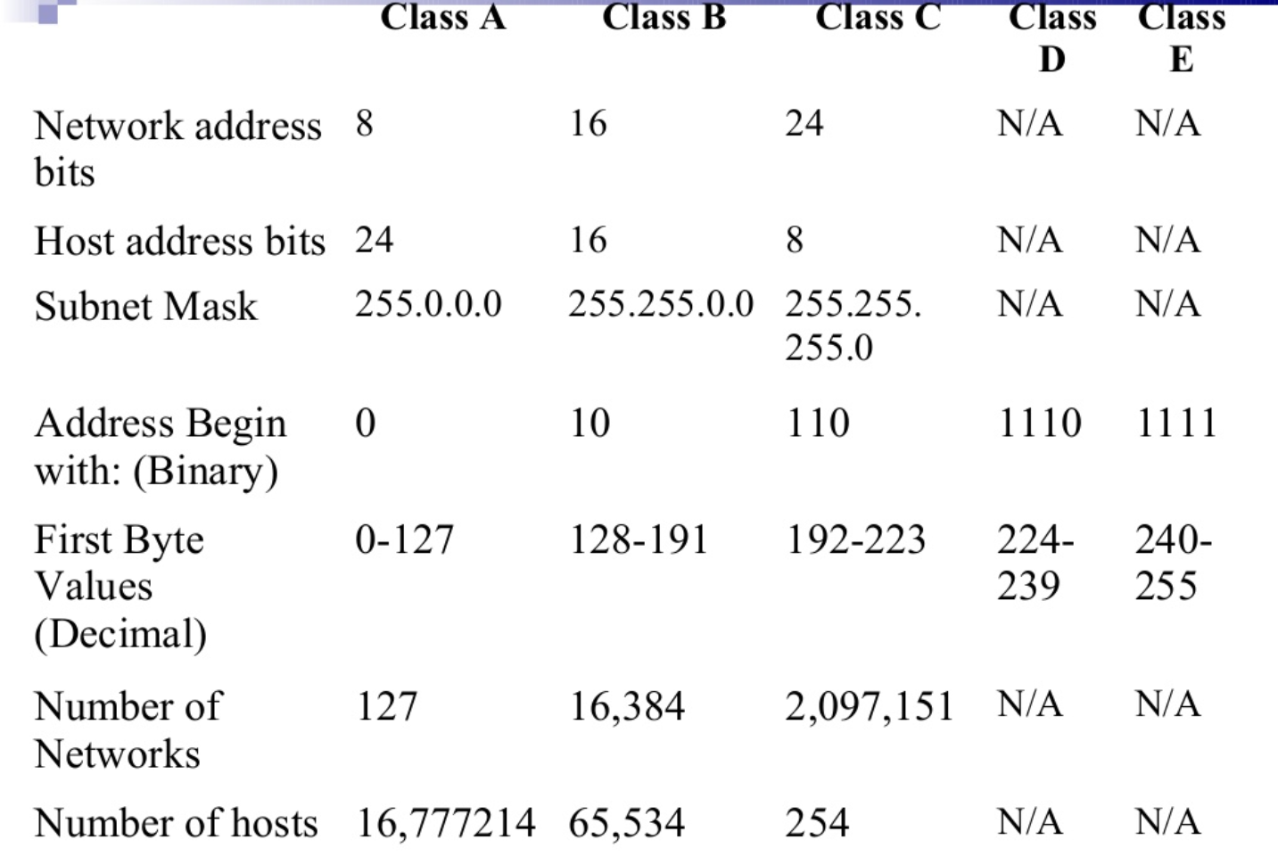

Slide 24
Routing
End systems and routers maintain routing tables
Indicate next router to which datagram should be sent
Static
Tables do not change but may contain alternative routes
Dynamic
If needed, the tables are dynamically updated
Flexible response to congestion and errors
status reports issued by neighbors about down routers
Source routing
Source specifies route as sequential list of routers to be followed
useful, for example, if the data is top secret and should follow a set of trusted routers.
Route recording
routers add their address to datagrams
good for tracing and debugging purposes

